Slide 1






Kaiming He: Single Image Haze Removal Using Dark Channel Prior
CVPR’09 Best Paper
Shang Gao

Slide 2










Outline
Introduction
Preliminaries
Dark Channel Prior Haze Removal
Discussions & Conclusions

Slide 3



Introduction

Slide 4

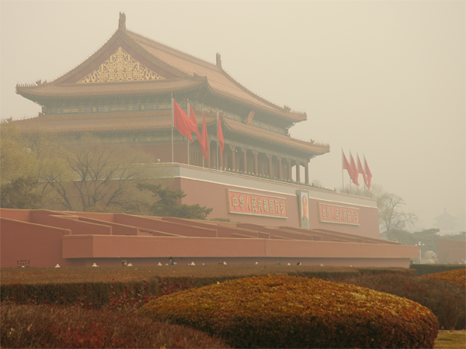
Image Degrade
Haze, fog, and smoke are phenomena due to atmospheric absorption and scattering.
Caused by turbid medium: water-droplets and small floating particles such as dust and smoke in the air.
Images degraded: lose the contrast and color fidelity
Example of Hazy Image

Slide 5
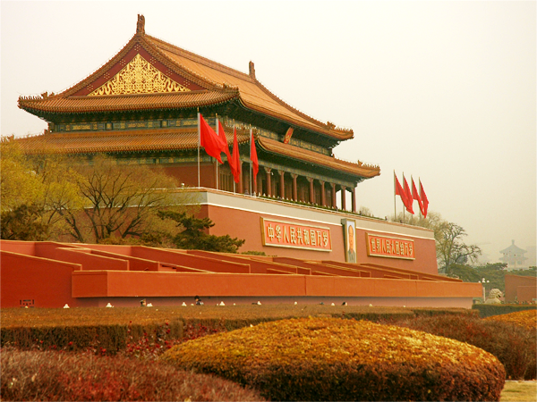
Haze Removal
Hazy Image
Haze Free Image

Slide 6
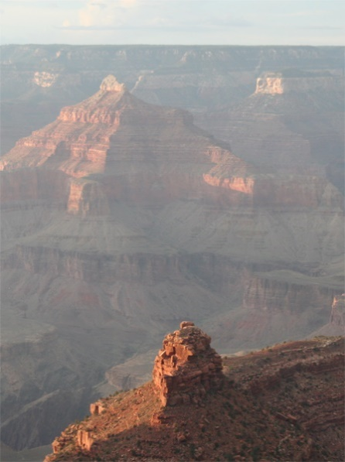
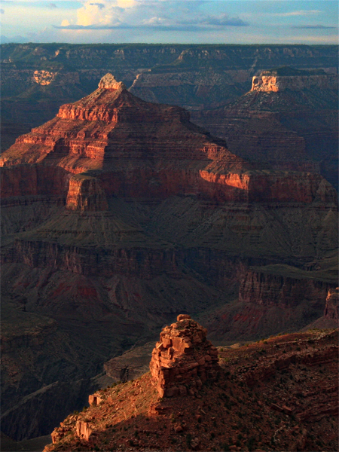
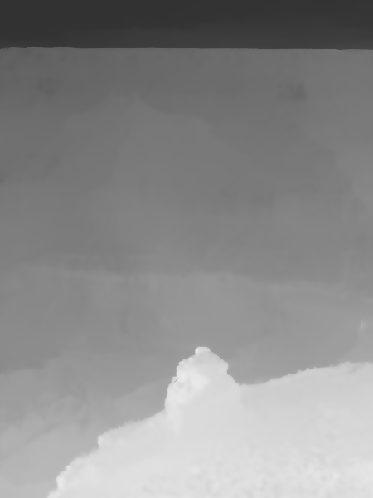
Goal
Raw Hazy Image
Haze Free Image
Depth Information

Slide 7

Preliminaries

Slide 8

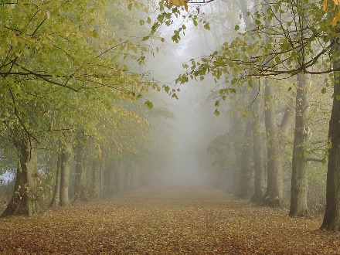
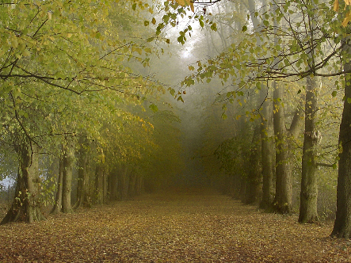
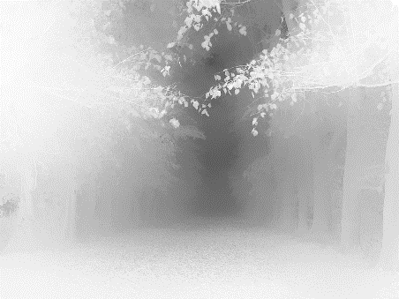
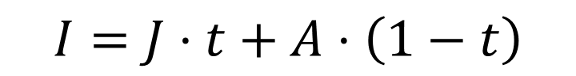
Atmospheric light
Haze Imaging Model
$$I=J⋅t+A⋅\left(1−t\right)$$
Hazy Image
Scene radiance
(Haze Free Image)
Transmission
● Transmission: 描述无法散射并到达照相机的光的介质传输率

Slide 9
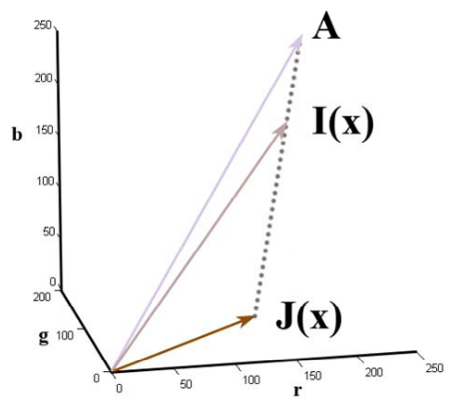
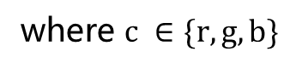
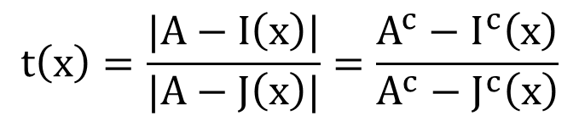
RGB Color Space
$$t\left(x\right)=\frac{|A−I\left(x\right)|}{|A−J\left(x\right)|}=\frac{A^{c}−I^{c}\left(x\right)}{A^{c}−J^{c}\left(x\right)}$$
where $c ∈\{r, g, b\}$
● vectors A, I(x), and J(x) are coplanar and their end points are collinear

Slide 10
Haze Imaging Model
$$I=J⋅t+A⋅\left(1−t\right)$$
Direct attenuation
Airlight
● Direct attenuation (直接衰减): 描述了场景辐射和其在介质中的衰减
● Airlight (空气光): 来自于之前所提的散射的光并会导致场景颜色的偏移
Notes:
Jt:乘性项改变图像对比度和色彩变化
A(1-t):加性项改变暗像素的亮度

Slide 11

Haze Imaging Model
$$I=J⋅t+A⋅\left(1−t\right)$$
Atmosphere is homogenous
(大气介质均匀?)
$$t=e^{−β d}$$
Scattering Coefficient
(大气散射系数)
Scene Depth

Slide 12
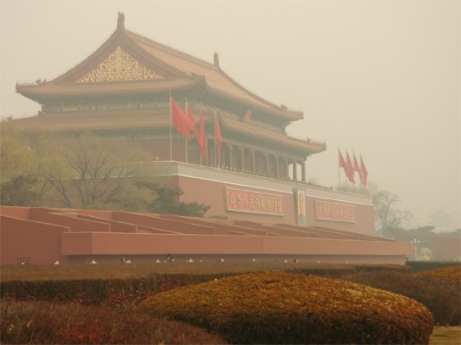
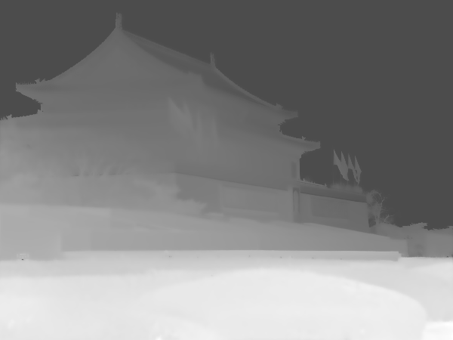
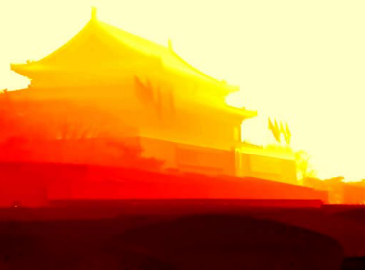
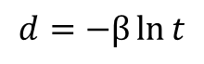
Scene Depth
$$d=−β\ln{t}$$
Raw Image
Transmission
Depth

Slide 13

Dark Channel Prior Haze Removal

Slide 14

Dark Channel Prior
In most of the non-sky patches, at least one color channel has very low intensity at some pixels.

Slide 15
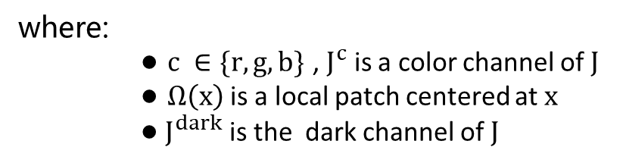
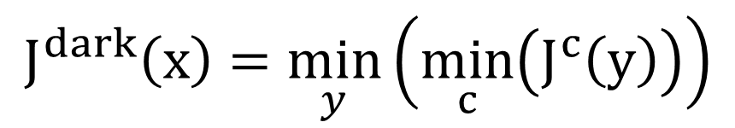
Dark Channel Prior
For an image J, define:
$$J^{dark}\left(x\right)=\min_{y}\left(\min_{c}\left(J^{c}\left(y\right)\right)\right)$$
where:
● $c ∈\{r, g, b\}$ , $J^{c}$ is a color channel of $J$
● $Ω\left(x\right)$ is a local patch centered at $x$
● $J^{dark}$ is the dark channel of $J$

Slide 16
Dark Channel Prior
For an image J, define:
$$J^{dark}\left(x\right)=\min_{y}\left(\min_{c}\left(J^{c}\left(y\right)\right)\right)$$
Input Image
min (r, g, b)

Slide 17
Dark Channel Prior
Darkest
For an image J, define:
15 x 15 patch
$$J^{dark}\left(x\right)=\min_{y}\left(\min_{c}\left(J^{c}\left(y\right)\right)\right)$$
Input Image
min (r, g, b)
Dark Channel

Slide 18
Observation: Hazy Image

Slide 19
Observation: Haze Free Image

Slide 20
Observation: Haze Free Image

Slide 21
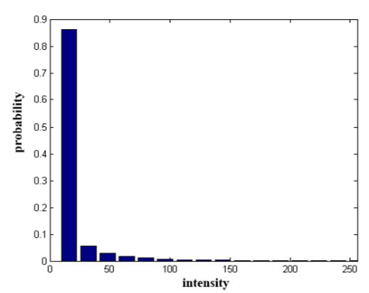
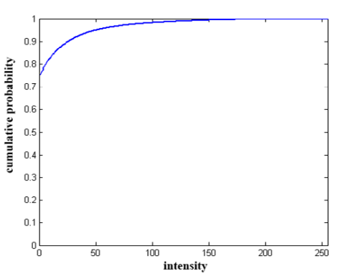
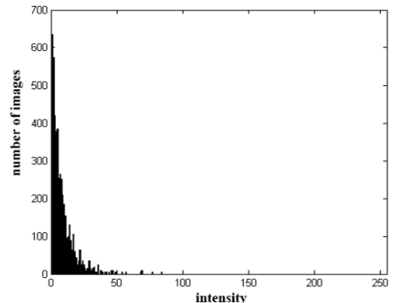
Observation: Statistics

Slide 22
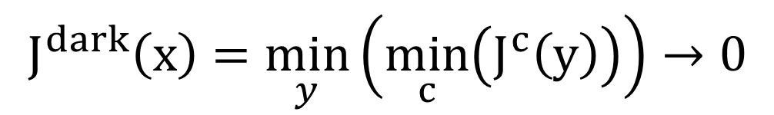
Observation
In most cases, for an outdoor haze free image J:
$$J^{dark}\left(x\right)=\min_{y}\left(\min_{c}\left(J^{c}\left(y\right)\right)\right)→0$$

Slide 23
What makes it dark?
Shadow
Colorful object
Black object

Slide 24
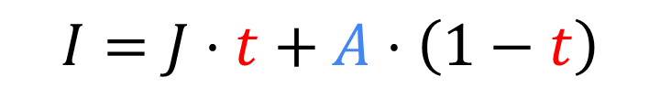
Estimating the Transmission
Atmospheric light
(Assume Given)
$$I=J⋅t+A⋅\left(1−t\right)$$
Hazy Image
Scene radiance
(Haze Free Image)
Transmission

Slide 25
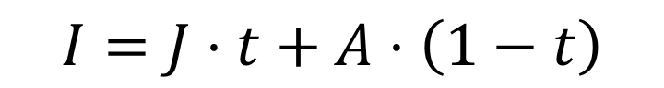
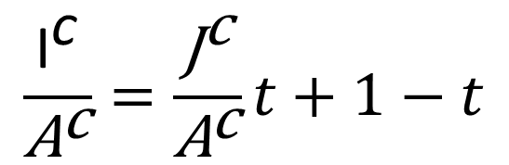
Estimating the Transmission
$$I=J⋅t+A⋅\left(1−t\right)$$
Normalization for each RGB channel:
$$\frac{{\text{I}}^{\text{c}}}{{\text{A}}^{\text{c}}}=\frac{{\text{J}}^{\text{c}}}{{\text{A}}^{\text{c}}}t+1−t$$

Slide 26
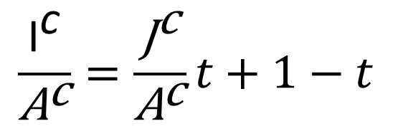

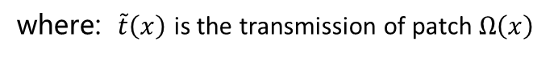
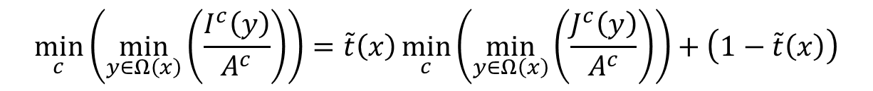
Estimating the Transmission
$$\frac{{\text{I}}^{\text{c}}}{{\text{A}}^{\text{c}}}=\frac{{\text{J}}^{\text{c}}}{{\text{A}}^{\text{c}}}t+1−t$$
Assume the Atmospheric light $\text{A}$ is given and the transmission $t$ in a local patch $Ω\left(x\right)$ is constant:
$$\min_{c}\left(\min_{y∈Ω\left(x\right)}\left(\frac{I^{c}\left(y\right)}{A^{c}}\right)\right)=\tilde{t}\left(x\right)\min_{c}\left(\min_{y∈Ω\left(x\right)}\left(\frac{J^{c}\left(y\right)}{A^{c}}\right)\right)+\left(1−\tilde{t}\left(x\right)\right)$$
where: $\tilde{t}\left(x\right)$ is the transmission of patch $Ω\left(x\right)$

Slide 27
Recall: Dark Channel Prior
In most cases, for an outdoor haze free image J:
$$J^{dark}\left(x\right)=\min_{y}\left(\min_{c}\left(J^{c}\left(y\right)\right)\right)→0$$

Slide 28
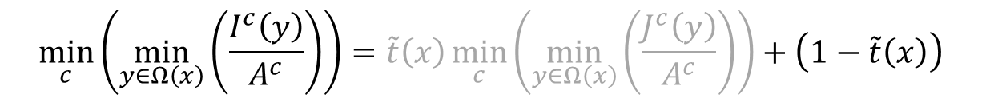

Estimating the Transmission
$$\min_{c}\left(\min_{y∈Ω\left(x\right)}\left(\frac{I^{c}\left(y\right)}{A^{c}}\right)\right)=\tilde{t}\left(x\right)\min_{c}\left(\min_{y∈Ω\left(x\right)}\left(\frac{J^{c}\left(y\right)}{A^{c}}\right)\right)+\left(1−\tilde{t}\left(x\right)\right)$$
$\tilde{t}\left(x\right)$ $=1−\min_{c}\left(\min_{y∈Ω\left(x\right)}\left(\frac{I^{c}\left(y\right)}{A^{c}}\right)\right)$

Slide 29
Aerial Perspective
The atmosphere is not absolutely free of any particle even in clear days.
The haze still exists when we look at distant objects.
The presence of haze is a fundamental cue for human to perceive depth.
If the haze is removed thoroughly, the image may seem unnatural and the feeling of depth may be lost.

Slide 30

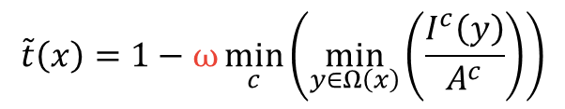

Estimating the Transmission
$\tilde{t}\left(x\right)$ $=1−\min_{c}\left(\min_{y∈Ω\left(x\right)}\left(\frac{I^{c}\left(y\right)}{A^{c}}\right)\right)$
Keep a very small amount of haze for the distant objects by introducing a constant parameter $\text{ω}\text{ (0<}\text{ω}\text{≤1)}$
$$\tilde{t}\left(x\right)=1−ω\min_{c}\left(\min_{y∈Ω\left(x\right)}\left(\frac{I^{c}\left(y\right)}{A^{c}}\right)\right)$$

Slide 31
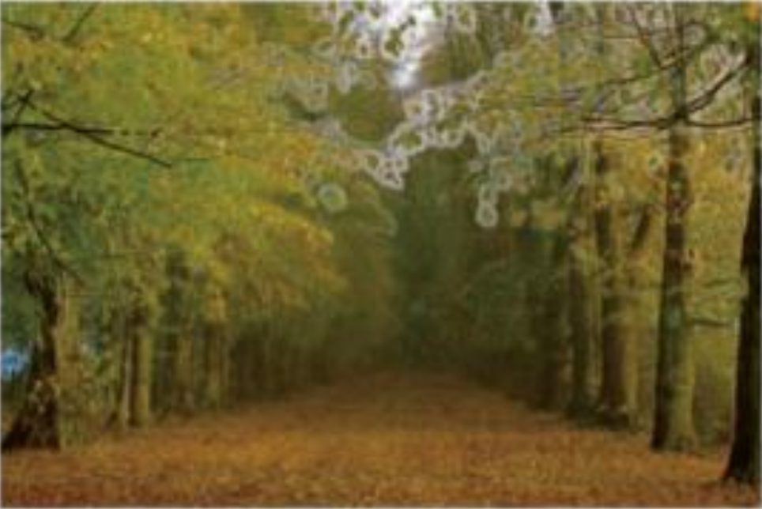


Example
$$\tilde{t}\left(x\right)=1−ω\min_{c}\left(\min_{y∈Ω\left(x\right)}\left(\frac{I^{c}\left(y\right)}{A^{c}}\right)\right)$$
$$I=J⋅t+A⋅\left(1−t\right)$$
Input I
Estimated t
Haze Free Image J

Slide 32
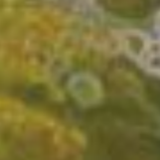
Soft Matting
Contains some block effects since the transmission is not always constant in a patch.
Input I
Estimated t
Haze Free Image J

Slide 33

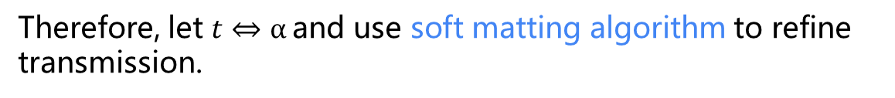
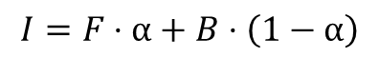
Soft Matting
Haze imaging model
$$I=J⋅t+A⋅\left(1−t\right)$$
Matting model [Levin et al., CVPR ‘06]
$$I=F⋅α+B⋅\left(1−α\right)$$
Foreground Color
Background Color
Foreground Opacity
Therefore, let $t⇔α$and use soft matting algorithm to refine transmission.

Slide 34
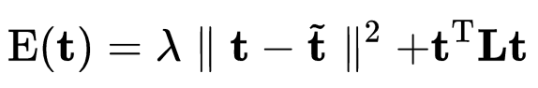
Soft Matting
Cost Function
Data term
Smoothness term
Regularization parameter
Matting Laplacian matrix

Slide 35

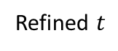
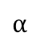
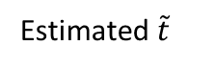
Soft Matting
Haze imaging model
$$I=J⋅t+A⋅\left(1−t\right)$$
Matting model [Levin et al., CVPR ‘06]
$$I=F⋅α+B⋅\left(1−α\right)$$
Input I
+
tri-map
$$α$$
Input I
Estimated $\tilde{t}$
Refined $t$

Slide 36
Estimating the Atmospheric Light
Use the dark channel to improve the atmospheric light estimation:
Pick the top 0.1% brightest pixels in the dark channel.
Among these pixels, the pixels with highest intensity in the input image I is selected as the atmospheric light.

Slide 37

Scene Radiance Restoration
Atmospheric light
$$I=J⋅t+A⋅\left(1−t\right)$$
Hazy Image
Haze Free Image
Transmission

Slide 38
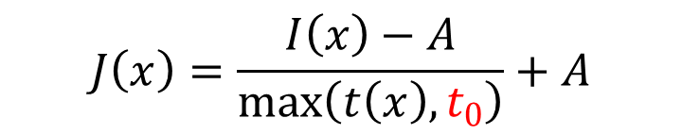
Scene Radiance Restoration
Atmospheric light
$$J\left(x\right)=\frac{I\left(x\right)−A}{\max\left(t\left(x\right),t_{0}\right)}+A$$
Haze Free Image
Hazy Image
Transmission

Slide 39

3333
Discussions & Conclusions

Slide 40

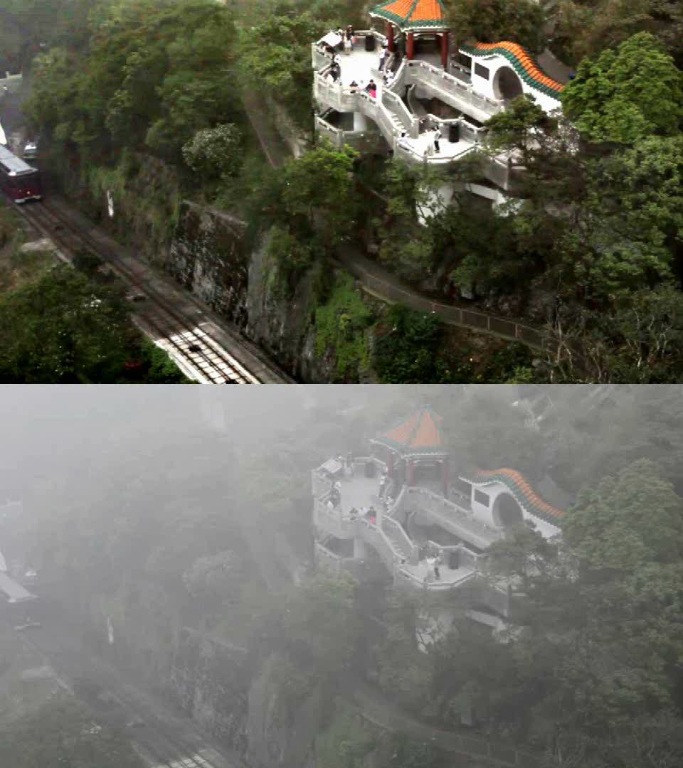
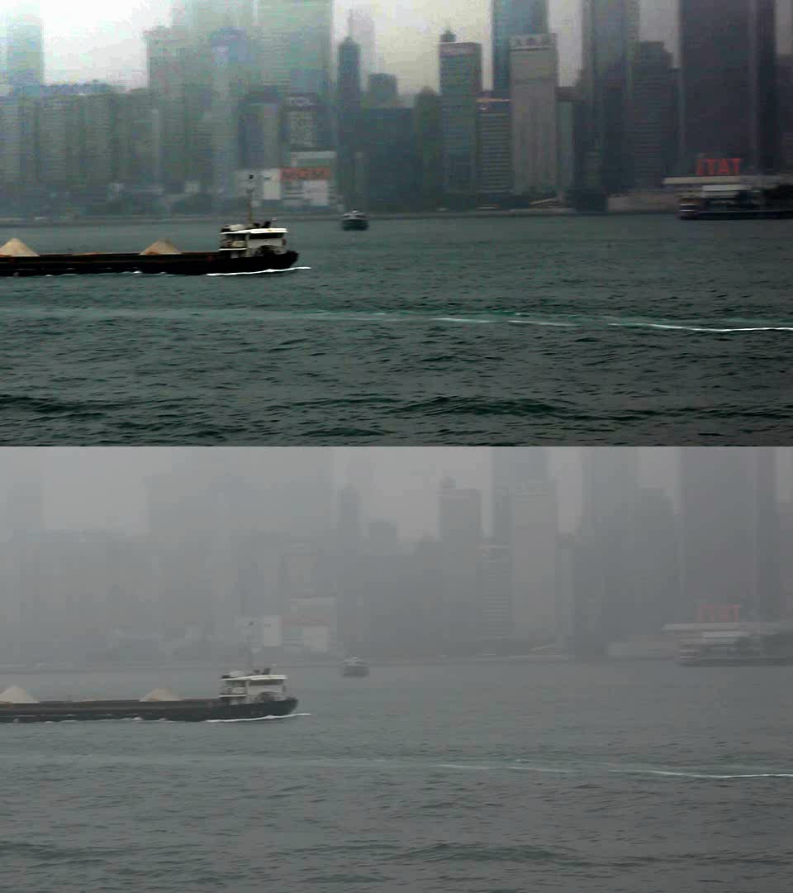
Applications: Video

Slide 41
Applications: De-Focus
Input Image
Depth
Haze Free Image

Slide 42
Applications: De-Focus
Input Image
Depth
De-Focused Haze Free Image

Slide 43
Recall
Darkest
For an image J, define:
15 x 15 patch
$$J^{dark}\left(x\right)=\min_{y}\left(\min_{c}\left(J^{c}\left(y\right)\right)\right)$$
Input Image
min (r, g, b)
Dark Channel

Slide 44
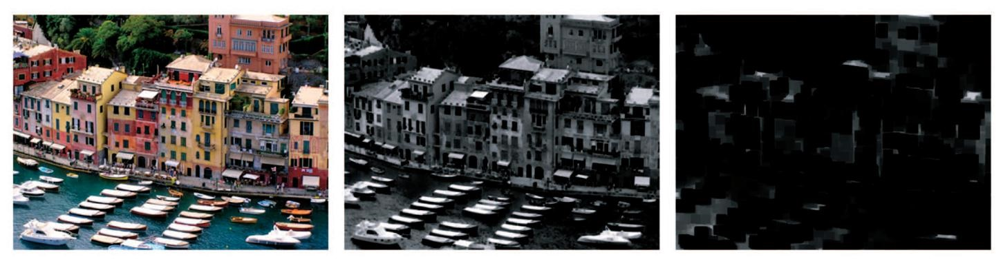
Patch Size
Haze Free Image
3 x 3 patch
15 x 15 patch
● 用小窗口恢复的图像有过饱和现象，而大窗口恢复的图像有光晕现象。

Slide 45
Recall
In most of the non-sky patches, at least one color channel has very low intensity at some pixels.

Slide 46

Estimate Transmission for Sky Patches
The color of the sky is usually very similar to the atmospheric light $A$ in a haze image.

Slide 47
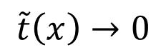
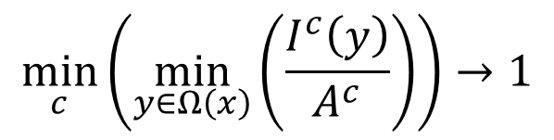
Estimate Transmission for Sky Patches
$$\min_{c}\left(\min_{y∈Ω\left(x\right)}\left(\frac{I^{c}\left(y\right)}{A^{c}}\right)\right)→1$$
$$\tilde{t}\left(x\right)→0$$

Slide 48
Limitations
Inherently white or grayish objects
Input Image
Transmission
(大理石的传输率被低估)
Result

Slide 49
Limitations
Haze imaging model is invalid
Input Image
Result
(non-constant 𝐴)

Slide 50
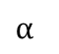
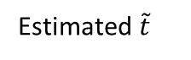
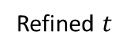
Limitations
Soft matting is slow
Input I
+
tri-map
$$α$$
Input I
Estimated $\tilde{t}$
Refined $t$

Slide 51
Conclusions
Dark channel prior
A natural phenomenon
Very simple but effective
Put a bad image to good use
Improvements
Replace Soft Matting with Guided Image Filtering [He et al., ECCV ‘10] (Next Week)

Slide 52

Thank You

